Slide 1
Spark Structure Streaming- Hands on Training

Slide 2
TOPICS
Spark Streaming Vs Spark Structure Streaming
Continuous Processing Model: Spark Structure Streaming
Anatomy of Streaming Query
Internals of Spark Structure Streaming
Fault Tolerance in Spark structure Streaming
Environment & Hands on
Stateless and Stateful Operations
Joins in Streaming Queries
Final Hands on

Slide 3
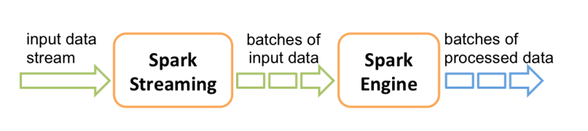
Spark Streaming Vs Spark Structure Streaming
Spark-Streaming
It provides us with the DStream API, which is powered by Spark RDD’s.
Spark Streaming works on something we call a micro batch
There is no such option in Spark Streaming to work on the data using the event-time. It only works with the timestamp when the data is received by the Spark, so less accurate data in case of late data arrival.

Slide 4
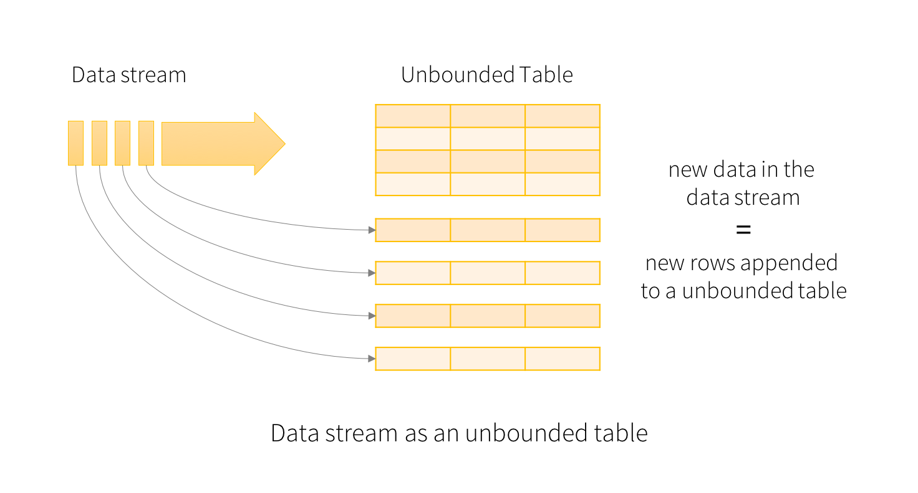
Spark Structure Streaming
Built on the Spark SQL library, Structured Streaming is another way to handle streaming with Spark. This model of streaming is based on Dataframe and Dataset APIs.
In Structured Streaming, there is no batch concept. The continuously flowing Data Stream gets appended to unbounded tables, over which all spark operation will run just like Dataframe/Dataset API
It works on event data, so late data handling is possible.

Slide 5
Structured Streaming
stream processing on Spark SQL engine
fast, scalable, fault-tolerant
rich, unified, high level APIs
deal with complex data and complex workloads
rich ecosystem of data sources
integrate with many storage systems

Slide 6

Continuous Processing Model: Spark Structure Streaming
Trigger: every 1 sec 2
Input: data from source as an append-only table
1
3
Time
Trigger: how frequently to check input for new data
Query: operations on input
usual map/filter/reduce new window, session ops
Input
data up to 1
data up to 2
data up to 3
Query

Slide 7
Result: final operated table
updated every trigger interval
Trigger: every 1 sec 2
1
3
Time
Output: what part of result to write
to data sink after every trigger
Input
data up to 1
data up to 2
data up to 3
Query
Complete output: Write full result table every time
Result
output for data up to 1
output for data up to 2
output for data up to 3
Output
complete output

Slide 8
Result: final operated table
updated every trigger interval
Trigger: every 1 sec 2
1
3
Time
Output: what part of result to write
to data sink after every trigger
Input
data up to 1
data up to 2
data up to 3
Query
Complete output: Write full result table every time
Delta output: Write only the rows that changed in result from previous batch
Append output: Write only new rows
*Not all output modes are feasible with all queries
Result
output for data up to 1
output for data up to 2
output for data up to 3
Output
delta output

Slide 9
API - Dataset/DataFrame
Static, bounded data
Streaming, unbounded data
Single API !

Slide 10




Anatomy of a Streaming Query
Example
Read JSON data from Kafka Parse nested JSON
Store in structured Parquet table Get end-to-end failure guarantees
ETL

Slide 11


Anatomy of a Streaming Query
spark.readStream.format("kafka")
.option("kafka.boostrap.servers",...)
.option("subscribe", "topic")
.load()
Source
Specify where to read data from
Built-in support for Files / Kafka / Kinesis*
Can include multiple sources of different types using join() / union()
returns a Spark DataFrame
(common API for batch & streaming data)

Slide 12

Anatomy of a Streaming Query
spark.readStream.format("kafka")
.option("kafka.boostrap.servers",...)
.option("subscribe", "topic")
.load()
Kafka DataFrame
key | value | topic | partition | offset | timestamp
[binary] | [binary] | "topic" | 0 | 345 | 1486087873
[binary] | [binary] | "topic" | 3 | 2890 | 1486086721

Slide 13

Anatomy of a Streaming Query
spark.readStream.format("kafka")
.option("kafka.boostrap.servers",...)
.option("subscribe", "topic")
.load()
.selectExpr("cast (value as string) as json")
.select(from_json("json", schema).as("data"))
Transformations
Cast bytes from Kafka records to a string, parse it as a json, and generate nested columns
100s of built-in, optimized SQL functions like from_json
user-defined functions, lambdas, function literals with map, flatMap…

Slide 14

Anatomy of a Streaming Query
spark.readStream.format("kafka")
.option("kafka.boostrap.servers",...)
.option("subscribe", "topic")
.load()
.selectExpr("cast (value as string) as json")
.select(from_json("json", schema).as("data"))
.writeStream
.format("parquet")
.option("path", "/parquetTable/")
Sink
Write transformed output to external storage systems
Built-in support for Files / Kafka
Use foreach to execute arbitrary code with the output data
Some sinks are transactional and exactly once (e.g. files)

Slide 15

Anatomy of a Streaming Query
spark.readStream.format("kafka")
.option("kafka.boostrap.servers",...)
.option("subscribe", "topic")
.load()
.selectExpr("cast (value as string) as json")
.select(from_json("json", schema).as("data"))
.writeStream
.format("parquet")
.option("path", "/parquetTable/")
.trigger("1 minute")
.option("checkpointLocation", "…")
.start()
Processing Details
Trigger: when to process data
Fixed interval micro-batches
As fast as possible micro-batches
Continuously (new in Spark 2.3)
Checkpoint location: for tracking the progress of the query

Slide 16




















































Batch Execution on Spark SQL
DataFrame/ Dataset
Logical Plan
Planner
Helluvalot of magic!
SQL AST
Analysis
Logical Physical Optimization Planning
Code
Generation
Selected
Physical RDDs Plan
Cost Model
DataFrame
Unresolved Logical Plan
Logical Plan
Optimized Logical Plan
Physical Plans
Dataset
Catalog
29

Slide 17



Batch Execution on Spark SQL
DataFrame/ Dataset
Logical Plan
Planner
Execution Plan
Run super-optimized Spark jobs to compute results
Project Tungsten - Phase 1 and 2
Code Optimizations
Bytecode generation
JVM intrinsics, vectorization Operations on serialized data
Memory Optimizations
Compact and fast encoding Offheap memory
30

Slide 18




Continuous Incremental Execution
DataFrame/ Dataset
Logical Plan
Incremental Execution Plan 1
Planner
Incremental Execution Plan 2
Planner knows how to convert streaming logical plans to a
continuous series of incremental
execution plans, for each processing the next chunk of streaming data
Incremental Execution Plan 3
Incremental Execution Plan 4
31

Slide 19






















Continuous Incremental Execution
Planner polls for
new data from sources
Planner
Incrementally executes
new data and writes to sink
Incremental Execution 1
Offsets: [19-105]
Count: 87
Incremental Execution 2
Offsets: [106-197]
Count: 92
32

Slide 20



















Continuous Aggregations
Maintain running aggregate as in-memory state backed by WAL in file system for fault-tolerance
Incremental Execution 1
Offsets: [19-105]
Running Count: 87
state: 87
Offsets: [106-179]
Incremental Exmeceumtiorny 2
Count: 87+92 = 179
state data generated and used across incremental executions
state: 179
33

Slide 21


















Fault-tolerance
Planner
All data and metadata in the system needs to be
recoverable / replayable
Incremental Execution 1
source
state
sink
Incremental Execution 2

Slide 22





Fault-tolerance
Fault-tolerant Planner
Planner
Offsets written to fault-tolerant WAL before execution
Tracks offsets by writing the
offset range of each execution to a write ahead log (WAL) in HDFS
Incremental Execution 1
e
t
source _{st} sink
a
Incremental Execution 2

Slide 23







Fault-tolerance
Fault-tolerant Planner
Failed Planner
Failed planner fails current execution
Tracks offsets by writing the
offset range of each execution to a write ahead log (WAL) in HDFS
Incremental Execution 1
e
t
source _{st} sink
a
Incremental Execution 2
Failed Execution

Slide 24




Fault-tolerance
Fault-tolerant Planner
Restarted
Planner
Offsets read back from WAL
Tracks offsets by writing the
offset range of each execution to a write ahead log (WAL) in HDFS
Incremental Execution 1
e
t
source _{st} sink
a
Reads log to recover from failures, and re-execute exact range of offsets
Incremental
Failed Execution
Execution 2
Same executions
regenerated from offsets

Slide 25

Fault-tolerance
Fault-tolerant Sources
Planner
Incremental Execution 1
e
t
_{st} sink
a
Incremental Execution 2
Structured streaming sources are by design replayable (e.g.
Kafka, Kinesis, files) and
generate the exactly same data given offsets recovered by planner
source
Replayable source

Slide 26

Fault-tolerance
Fault-tolerant State
Intermediate "state data" is a maintained in versioned, key- value maps in Spark workers, backed by HDFS
Planner
Incremental Execution 1
source sink
Incremental Execution 2
state
Planner makes sure "correct version" of state used to re- execute after failure
state is fault-tolerant with WAL

Slide 27

Fault-tolerance
Fault-tolerant Sink
Planner
Incremental Execution 1
e
t
source _{st}
a
Incremental Execution 2
Sink are by design idempotent, and handles re-executions to avoid double committing the
output
sink
Idempotent by design

Slide 28






Spark automatically streamifies!
Read from Kafka
Kafka Source
t = 1
t = 2
t = 3
spark.readStream.format("kafka")
.option("kafka.boostrap.servers",...)
.option("subscribe", "topic")
.load()
.selectExpr("cast (value as string) as json")
.select(from_json("json", schema).as("data"))
.writeStream
.format("parquet")
.option("path", "/parquetTable/")
.trigger("1 minute")
.option("checkpointLocation", "…")
.start()
Project
device, signal
Optimized Operator
codegen, off- heap, etc.
process new data
process new data
process new data
Filter
signal > 15
Write to Parquet
Logical Plan
Parquet Sink
Optimized Plan
DataFrames, Datasets, SQL
Series of Incremental Execution Plans
Spark SQL converts batch-like query to a series of incremental execution plans operating on new micro-batches of data

Slide 29
Fault-tolerance with Checkpointing
t = 1
t = 2
t = 3
Checkpointing
Saves processed offset info to stable storage
Saved as JSON for forward-compatibility
process new data
process new data
process new data
Allows recovery from any failure
Can resume after limited changes to your streaming transformations (e.g. adding new filters to drop corrupted data, etc.)
write ahead log
end-to-end exactly-once guarantees

Slide 30



Anatomy of a Streaming Query
spark.readStream.format("kafka")
.option("kafka.boostrap.servers",...)
.option("subscribe", "topic")
ETL
ETL
.load()
.selectExpr("cast (value as string) as json")
.select(from_json("json", schema).as("data"))
.writeStream
.format("parquet")
.option("path", "/parquetTable/")
.trigger("1 minute")
.option("checkpointLocation", "…")
.start()
Raw data from Kafka available as structured data in seconds, ready for querying

Slide 31
ENVIORNMENT SETUP & HANDS ON

